Slide 1
Chemistry – Feb 20, 2020
Get out the IMF WS for HMK check
P3 Challenge- Polyatomic Ion Quiz
Objective –
  Solutions and Solubility
Agenda –
  HMK review
  Solutions
  Saturation
  Solubility
Assignment: -
  Solutions Worksheet

Slide 2
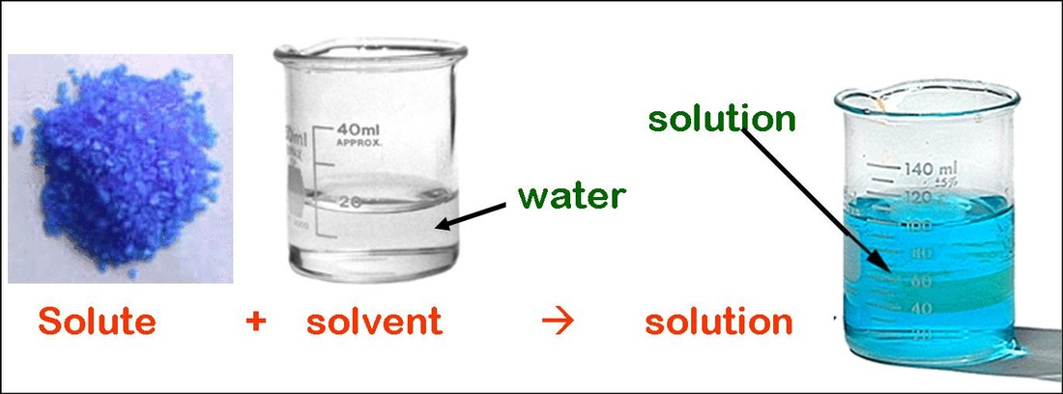
Solubility Definitions
Solute, Solvent, Solution
Solubility – The number of grams of a substance that can be dissolved in 100 g of solvent (usually water) at 25◦C.
  Temperature for solubility must be given because the higher the temperature, the more solute one can dissolve in a solvent.

Slide 3
Saturation
Unsaturated: A solution that contains less than the maximum amount of solute possible.
  Most solutions.
Saturated: A solution that contains the maximum amount of solute.
  Can identify because there will be solid solute present.
Supersaturated: A solution that contains more than the maximum amount of solute
  A rare and unstable condition that is difficult to create.

Slide 4
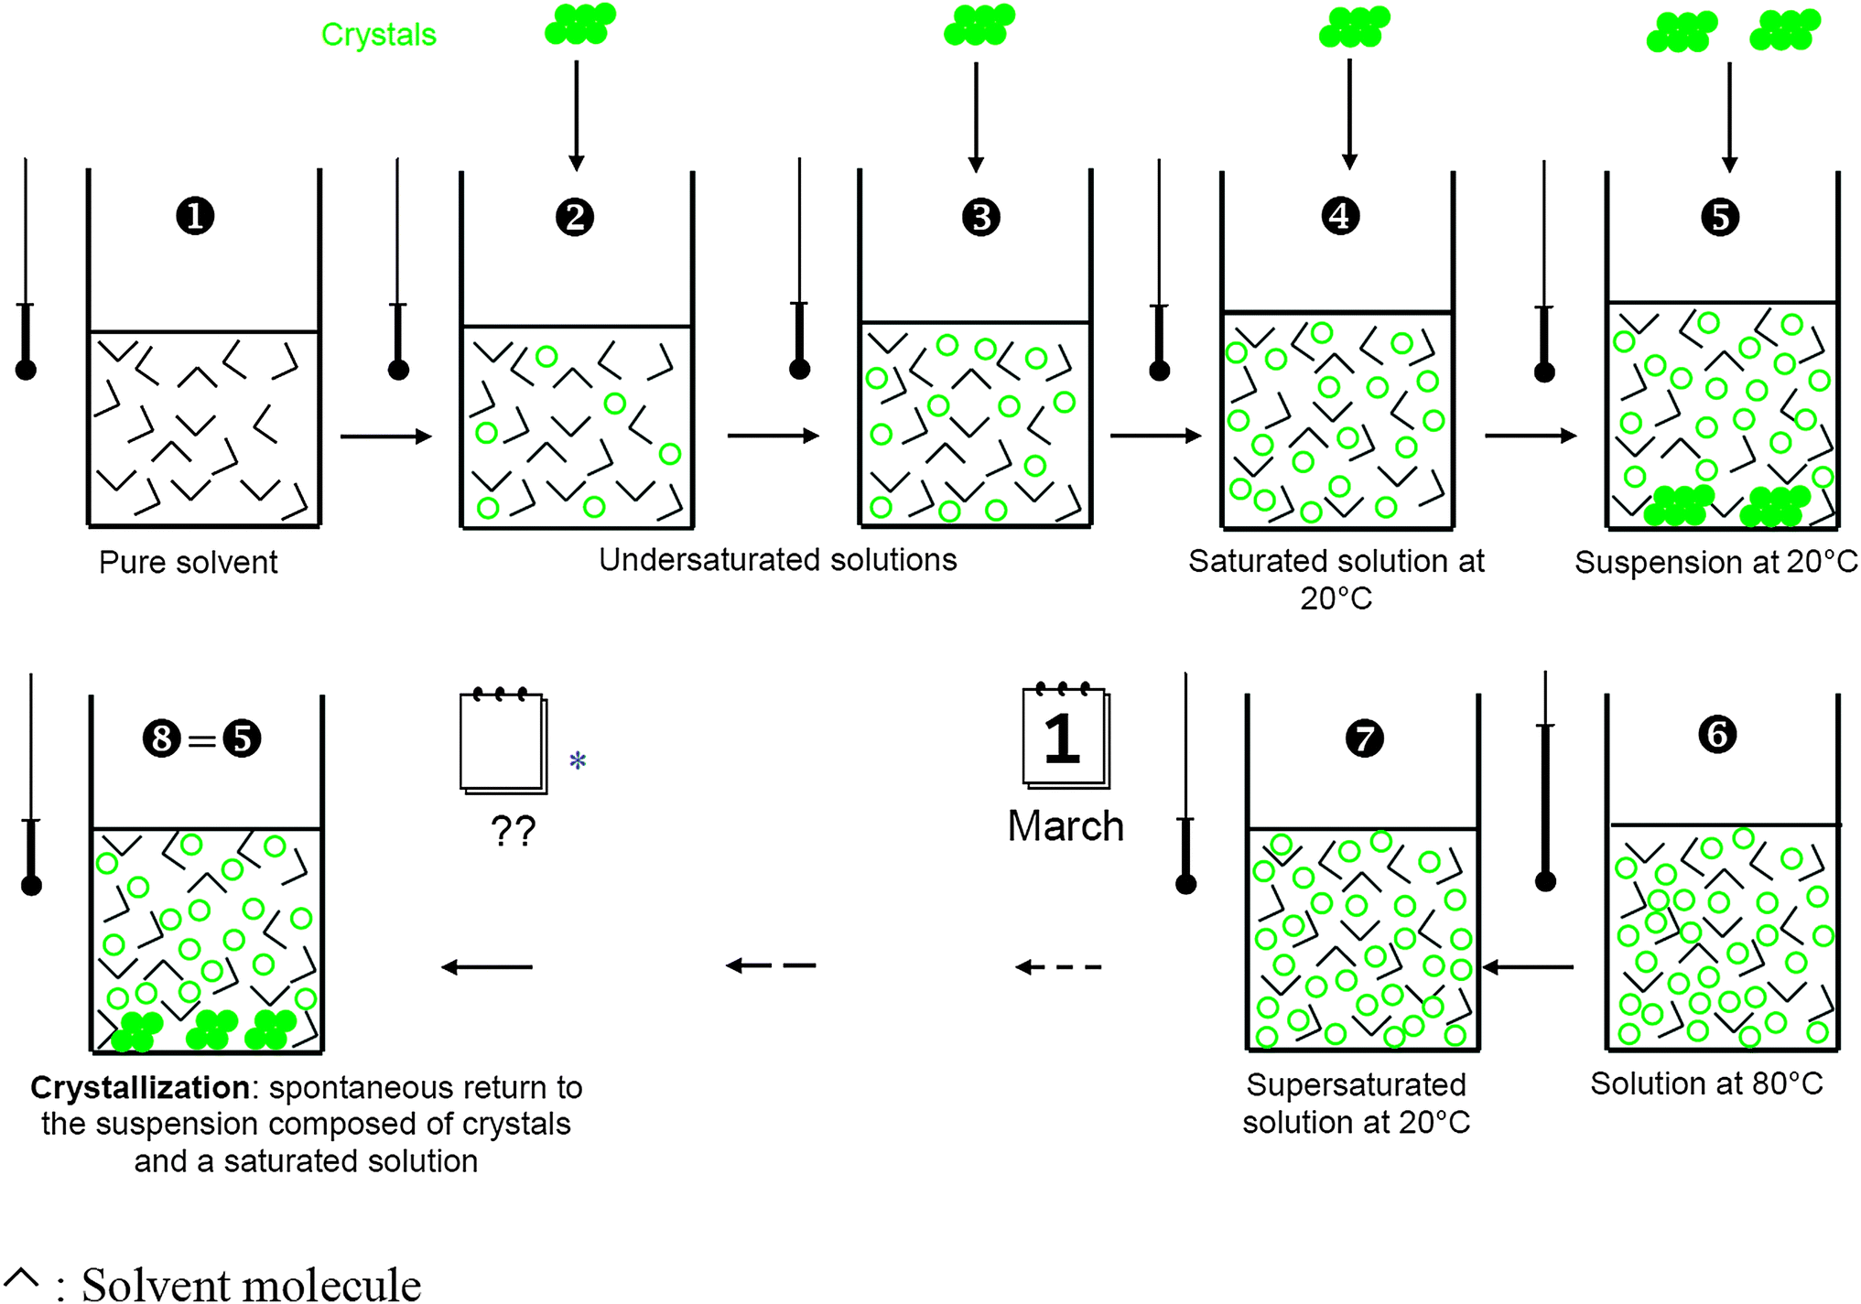

Slide 5
Example
The solubility of KNO₃ Potassium nitrate at 25 ◦C is 38.0 g in 100 g water.
If a solution contains 38.0 g in 100 g water at 25 ◦C, it is saturated.
If a solution contains less than 38.0 g in 100 g water at 25 ◦C, it is unsaturated.
If a solution contains more than 38.0 g in 100 g water at 25 ◦C, it is supersaturated.
https://www.youtube.com/watch?v=HnSg2cl09PI A supersaturated example of sodium acetate in water. (Pretty Crystal)
How do you create a supersaturated solution?
  Take a saturated solution, add extra solute, heat until all solute dissolves, then CAREFULLY and SLOWLY cool the solution back to the original temperature. The extra solid will stay in solution until a seed crystal is introduced, or the solution is agitated.

Slide 6
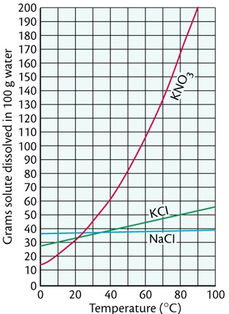
Solubility Curves
Plots the solubility at different temperatures for different substances.
Read solubility given temperature.
Read temperature for a given solubility.
Compare solubility of two temperatures.
For a solution described, determine saturated, unsaturated or supersaturated.
  On or above line: Saturated, Below line: Unsaturated Above line (special case): Supersaturated

Slide 7
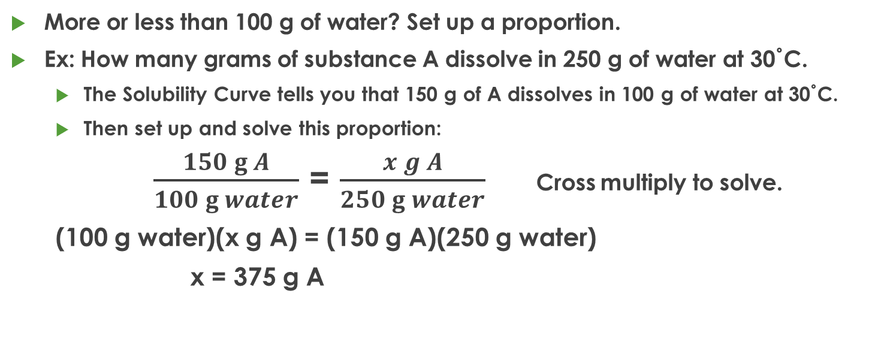
Solubility Calculations
More or less than 100 g of water? Set up a proportion.
Ex: How many grams of substance A dissolve in 250 g of water at 30˚C.
  The Solubility Curve tells you that 150 g of A dissolves in 100 g of water at 30˚C.
  Then set up and solve this proportion:
$\frac{150 g A}{100 g water}$ = $\frac{x g A}{250 g water}$ Cross multiply to solve.
  (100 g water)(x g A) = (150 g A)(250 g water)
  x = 375 g A

Slide 8
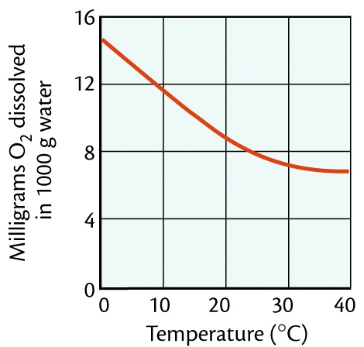
Solubility of Gases
For solids, as temperature increases, solubility increases.
For gases, as temperature increases, solubility decreases.
Note that the solubility of a gas is MUCH lower than solids.
  Milligrams in 1000 g water compared to grams in 100 g water
  10,000 times smaller solubility
Solubility curve used the same way.

Slide 9
Exit Slip - Homework
Exit Slip: How many grams of KNO₃ can be dissolved in 50.0 g of water at 50ºC?
What’s Due? (Pending assignments to complete.)
  Solutions Worksheet
What’s Next? (How to prepare for the next day)
  Read Holt p385-392

